Slide 1
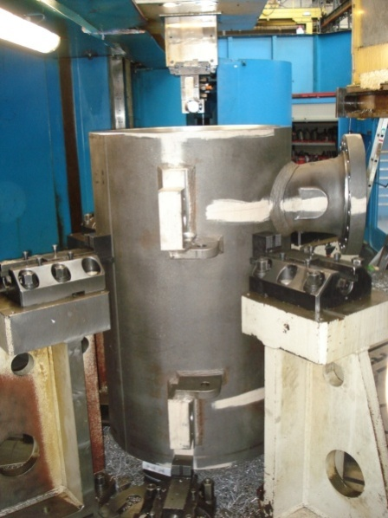
HS&E INCIDENT BULLETIN |  | 2nd Quarter 2012
Type of Incident: | Laceration
Summary:
On the VTN vertical lathe, the IP was about to go down inside the machined carter in order to check a dimension when he slips. His elbow hurt the inside diameter of the carter (cutting edge)
Root Causes: | Actions Taken Thus Far: Next Steps
People -Improper use of tool, equipment or material Procedures -Incomplete procedure/instructions Equipment -Inadequate or improper PPE (proper PPE not available) | Benchmark Olean for good practice on dimension checking inside machined carters Find a measurement device to check dimensions inside the carters without going down inside Find adapted arm protection (PPE)

